Slide 1

team_some_name
Data 607, Fall 2023
Team members:
Warner Alexis
John Droescher
Shaya Engelman
Heleine Fouda
Fomba Kassoh

Slide 2
Table of Contents
Data Collection and Preparation
Initial Response Analysis
Further Response Analysis and Demographics
Demographic and Response Final Analysis
Conclusion

Slide 3
Data Collection & Preparation
Data Collection: Survey
Responses were not restricted to ranking only 5 skills
Survey was distributed to group members’ networks – likely biased
Limited time-frame for distribution and collection
Data Preparation: Pandas
Directly ingested from Google Sheets into Pandas
Converted categorical responses to ranking 1-5.
Isolated valid / invalid responses based on number of entries and total score per response

Slide 4
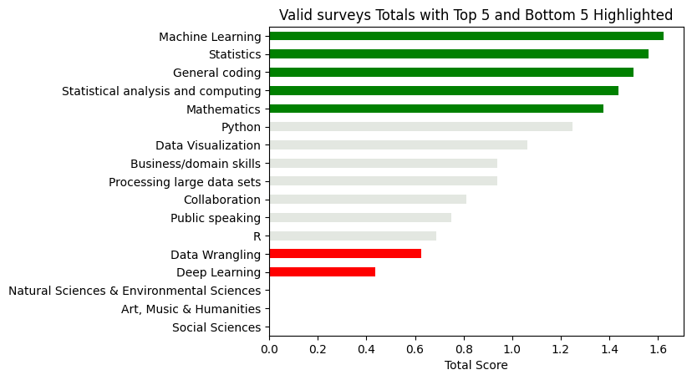
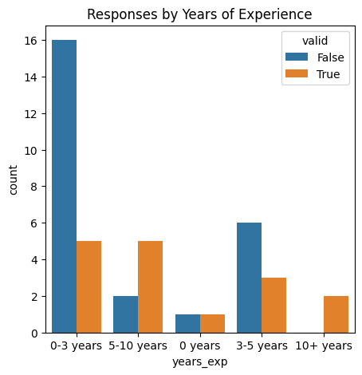
Initial Response Analysis
Statistics, Coding and Machine Learning are most valued
Softer skills are all in the gray area
Correlation between valid responses and experience

Slide 5
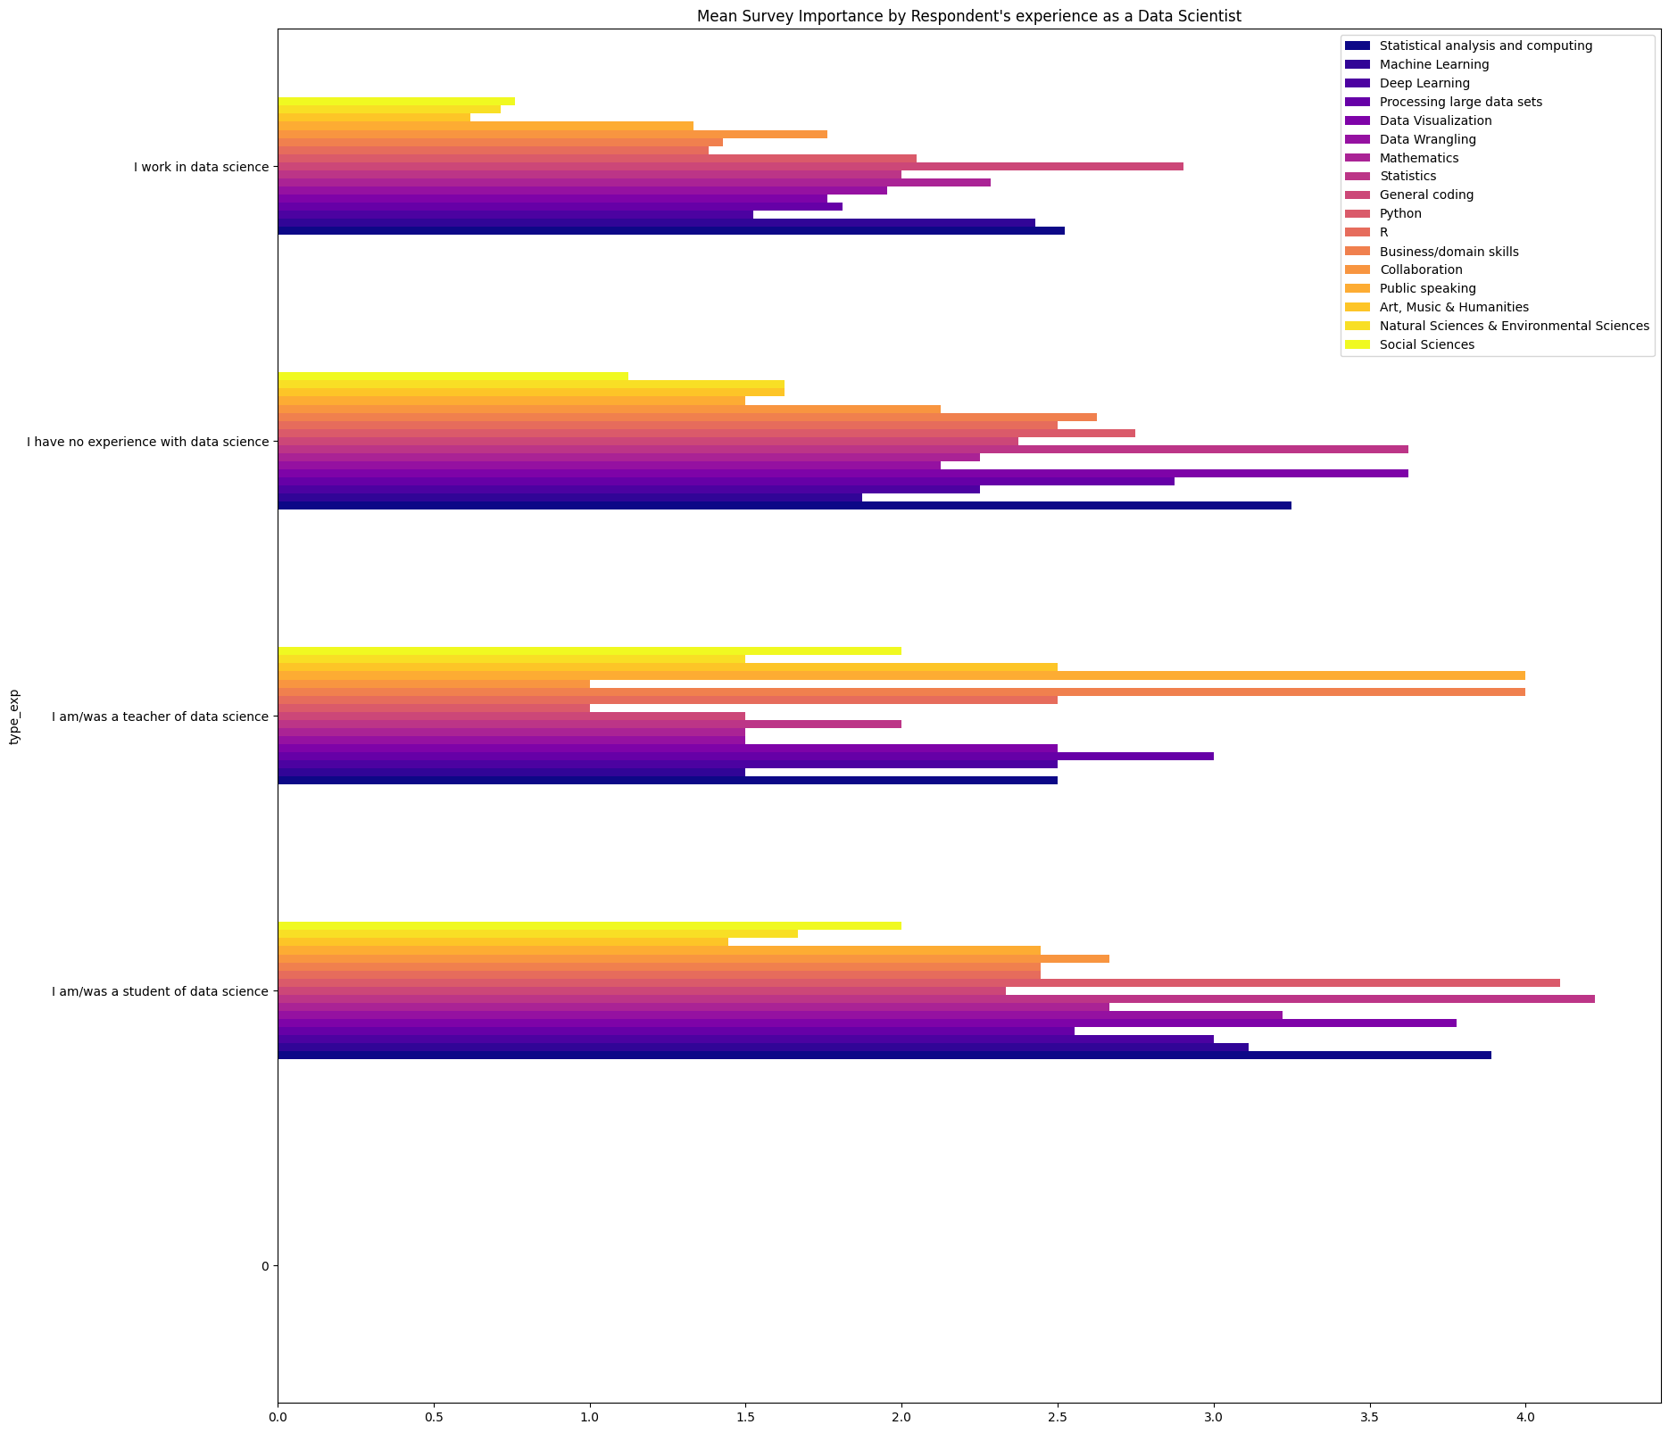
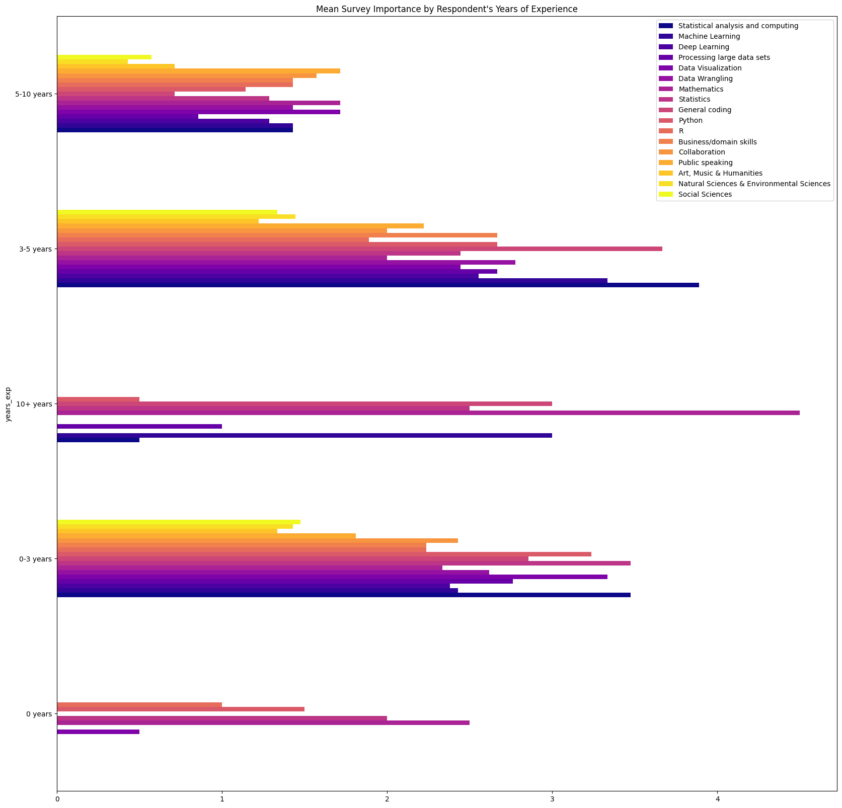
Further Response Analysis by Demographic

Slide 6
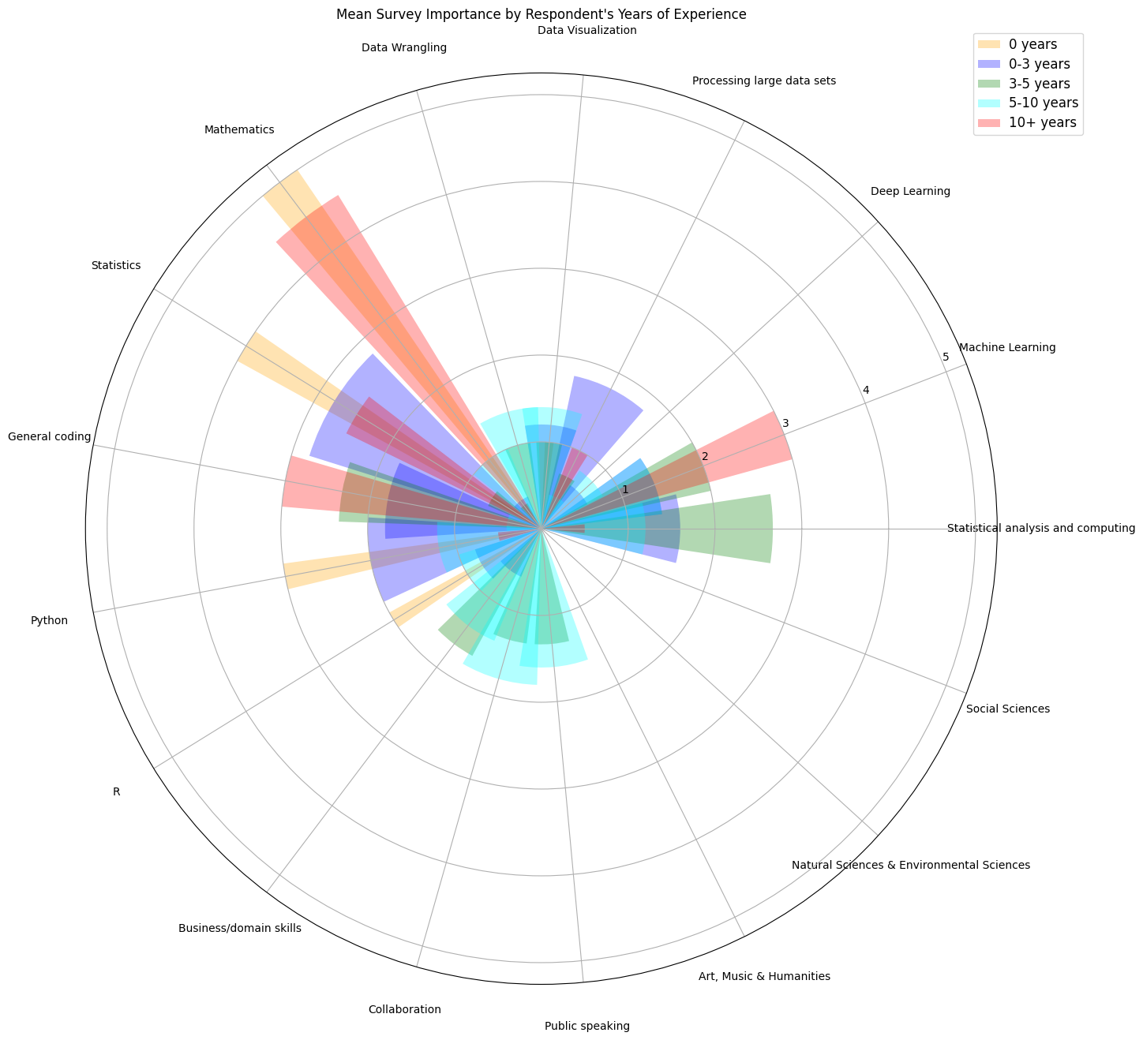
Demographic and Response Analysis
Clear divergences between experience groups
Some expected differences
Less experienced valued technical skills
More experienced valued softer skills

Slide 7
Conclusion
There is a disconnect between the critical skills identified by students and entry level data scientists versus the critical skills identified by senior data scientists.
This can lead to frustration when applying for new jobs and hoping for promotions
This can lead to frustrations on collaborative projects

